Slide 1
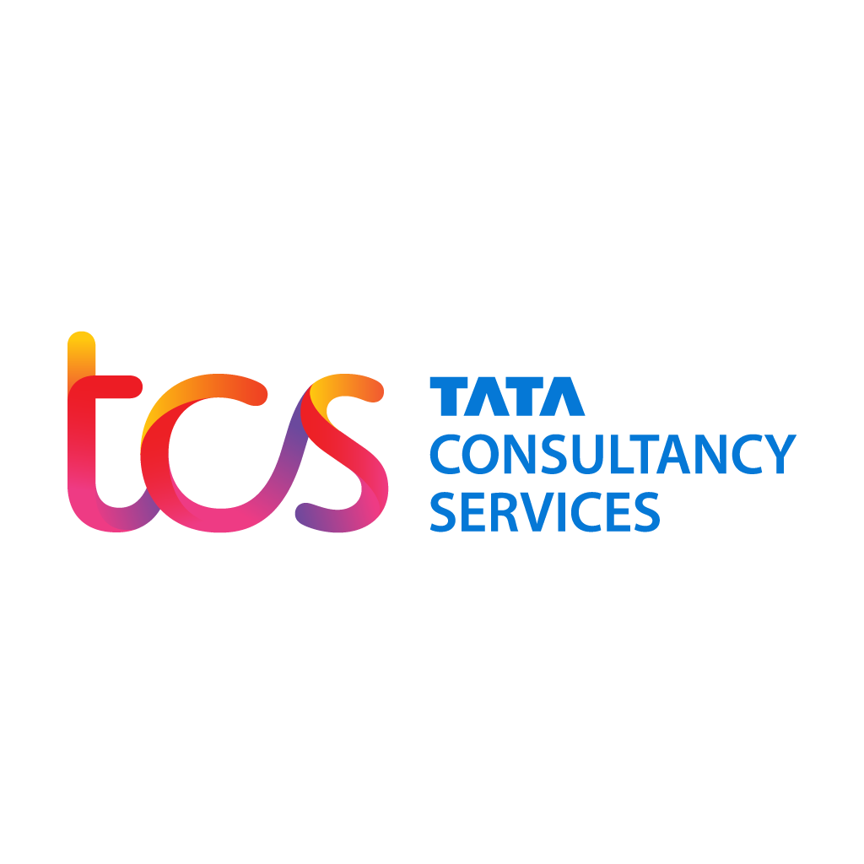
TCS Workforce Attrition Analysis
Business Analytics Project | 2020–2024
Debapriya Nayak

Slide 2
Objective
To analyze TCS workforce and attrition trends using Power BI, and forecast future attrition for better strategic HR planning.

Slide 3
TCS Workforce Attrition Analysis Data
Year | Total Employees | Attrition Rate (%)
2020 | 448464 | 12.1
2021 | 509058 | 11.9
2022 | 592195 | 17.4
2023 | 614795 | 20.1
2024 | 603305 | 13

Slide 4
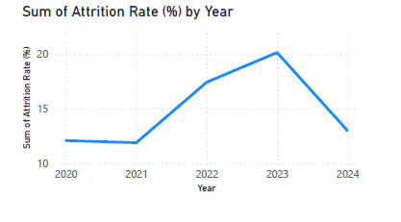
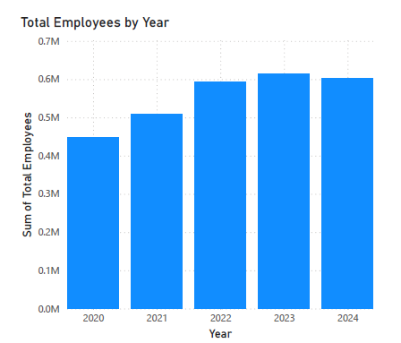
Power BI Dashboard Overview
Includes visuals for Attrition Rate over Years, Total Employees trend, and forecasting using built-in analytics.

Slide 5
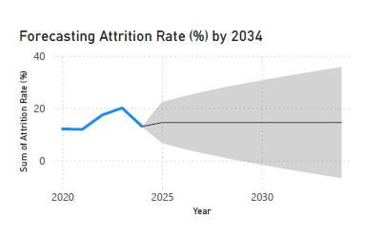
Forecast Insight
Forecast predicts attrition will decline slightly in 2025 (from 17.0% in 2024 to ~15%).
This suggests improving employee retention efforts post-COVID business cycles.
High attrition in 2022–23 possibly linked to IT sector volatility and market hiring trends.
Stabilization in recent years shows HR interventions may be effective

Slide 6
Strategies to Reduce Attrition at TCS
1. Data-Driven Retention Analysis – Use predictive analytics to spot high-risk employees early.
2. Personalized Career Development Plans – Map roles to upskilling paths and internal promotions.
3. Competitive Compensation Benchmarking – Align pay structures with market trends.
4. Improved Manager-Employee Communication – Enable frequent feedback and transparent leadership.
5. Employee Wellness and Mental Health Support – Offer mental health resources and wellness initiatives.

Slide 7
Conclusion
TCS shows resilience and control over workforce dynamics. Forecasts suggest positive trends, aiding strategic decision-making.

